Slide 1


TEAM JASS
TECHNO INDIA UNIVERSITY
MAJOR Project
TOPIC :- DATA SENSE using AI
4TH Semester
STREAM :- MCA 2B
SESSION :- 2024-2026
DATE :- 20.05.2026
This Photo by Unknown Author is licensed under CC BY-SA-NC

Slide 2
:TEAM MEMBERS:
Tandrima Nandy (241001271061)
Saptarchi Datta (211001091001)
Subhadip Maity (241001271128)
Arya Kumar Pal (241001271119)
Shawan Sur (241001271077)
This Photo by Unknown Author is licensed under CC BY-SA-NC

Slide 3
Introduction :
AI has revolutionized modern data analytics
DataSense AI automates data cleaning, analysis, and visualization
Designed for students, researchers & non-technical users
What is DataSense AI?
A sophisticated system designed to analyze raw, unstructured data.
Utilizes AI algorithms to identify hidden patterns.
Bridge the gap between big data and human decision-making.
Core Goal: To automate the data interpretation process and provide high-accuracy predictive insights.
This Photo by Unknown Author is licensed under CC BY-SA-NC

Slide 4
Problem Statement :
Manual data analysis is time-consuming.
                Requires technical skills
                Lack of integrated AI-based analytics tools
The Data Overload: Organizations are drowning in "Dark Data" (unstructured information).
Manual Bottlenecks: Manual analysis is slow, expensive, and prone to error.
The Need: A system that can digest massive datasets and provide "Smarter, Faster, and more Accurate" interpretations.
This Photo by Unknown Author is licensed under CC BY-SA-NC

Slide 5
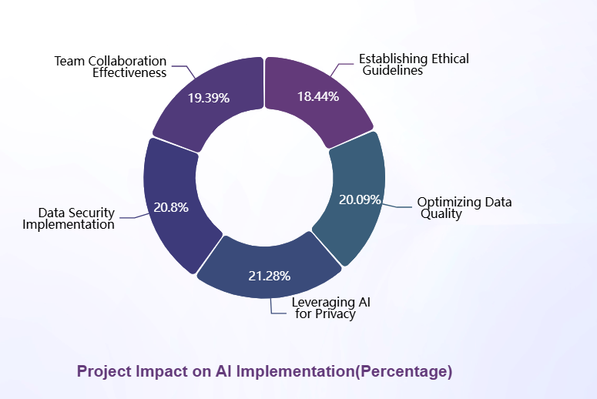
This Photo by Unknown Author is licensed under CC BY-SA-NC

Slide 6
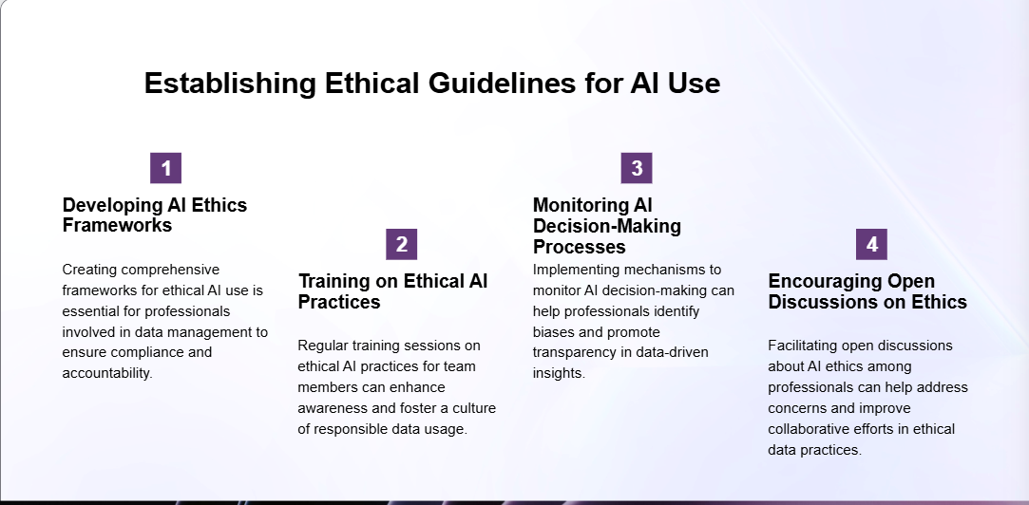
This Photo by Unknown Author is licensed under CC BY-SA-NC

Slide 7
Technology Stack
:Frontend :
HTML
CSS
:Backend :
Python
Flask
: Libraries :
Pandas
NumPy
Matplotlib
Plotly
Scikit-learn
This Photo by Unknown Author is licensed under CC BY-SA-NC

Slide 8
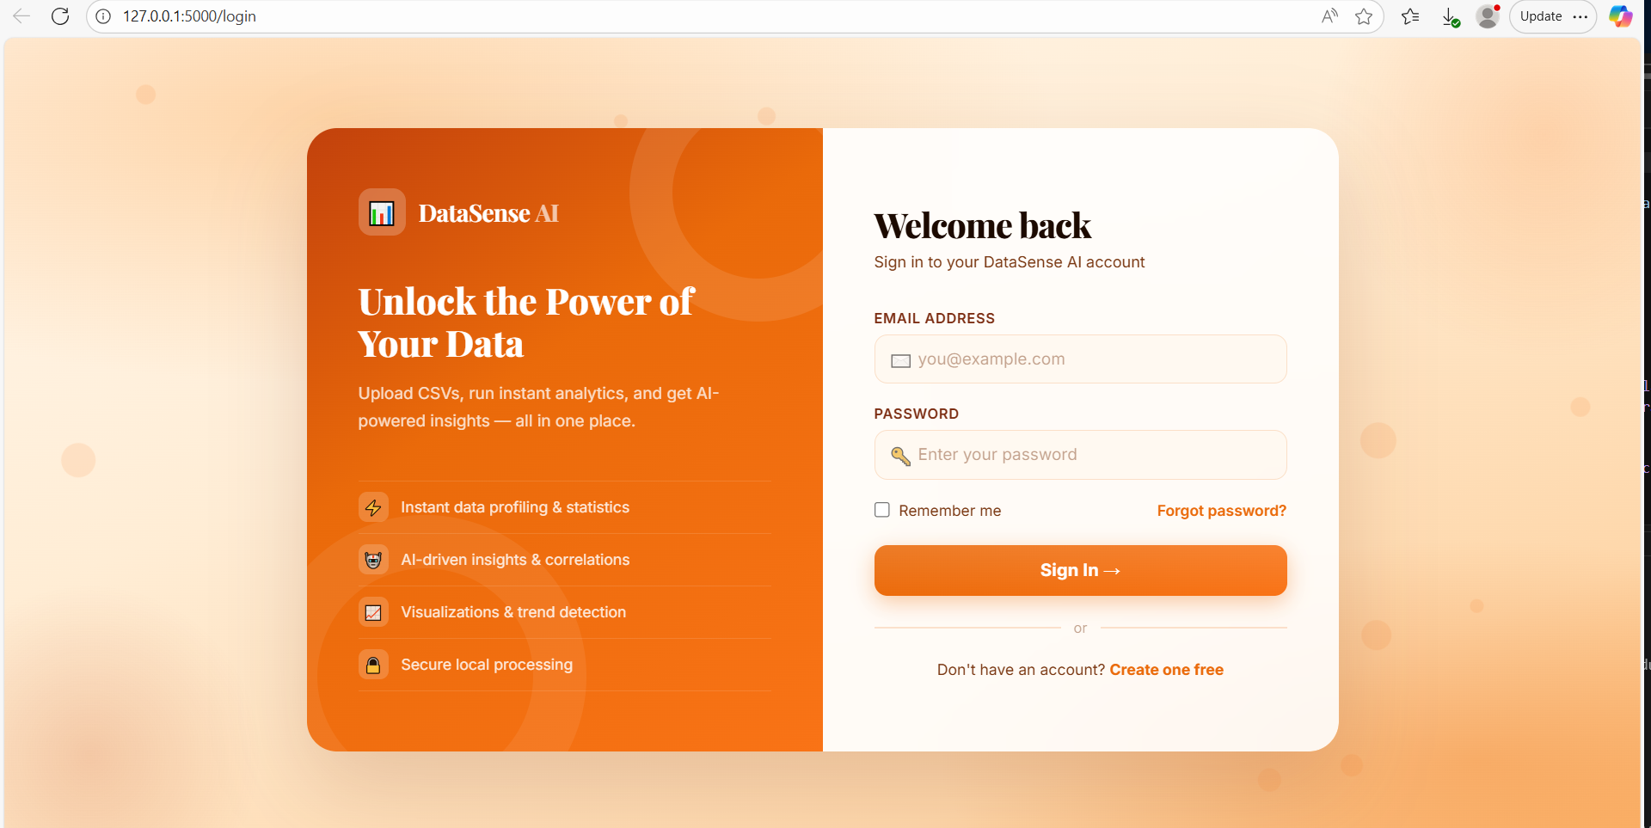
: Login Page :
This Photo by Unknown Author is licensed under CC BY-SA-NC

Slide 9
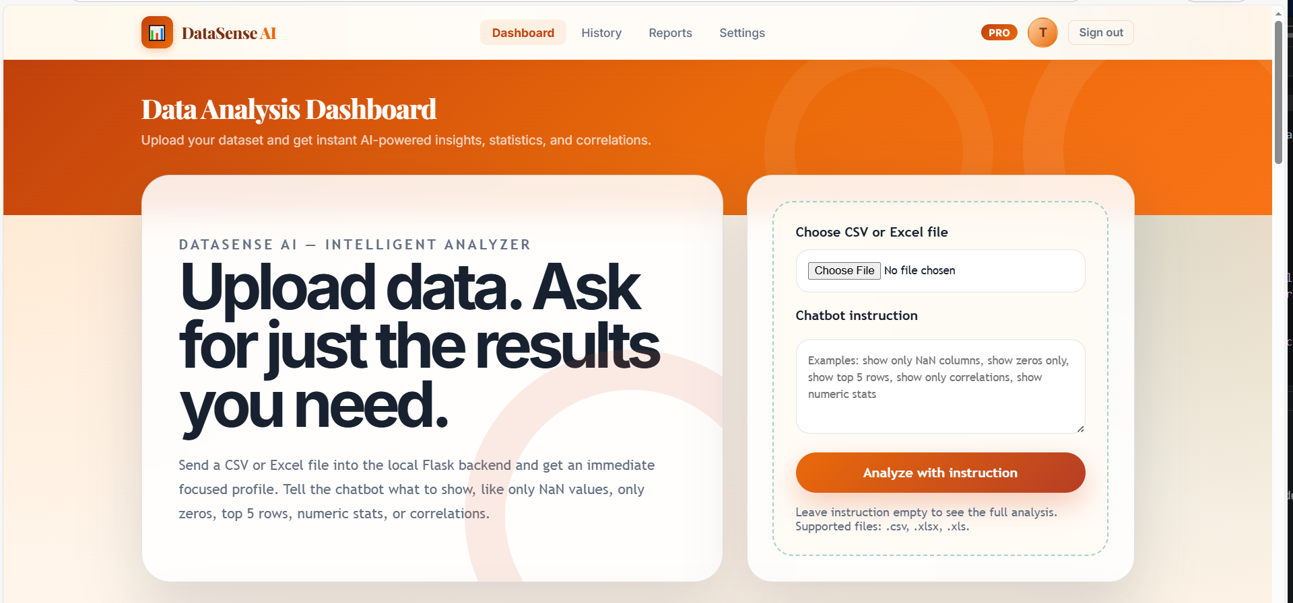
: HOME PAGE :
This Photo by Unknown Author is licensed under CC BY-SA-NC

Slide 10
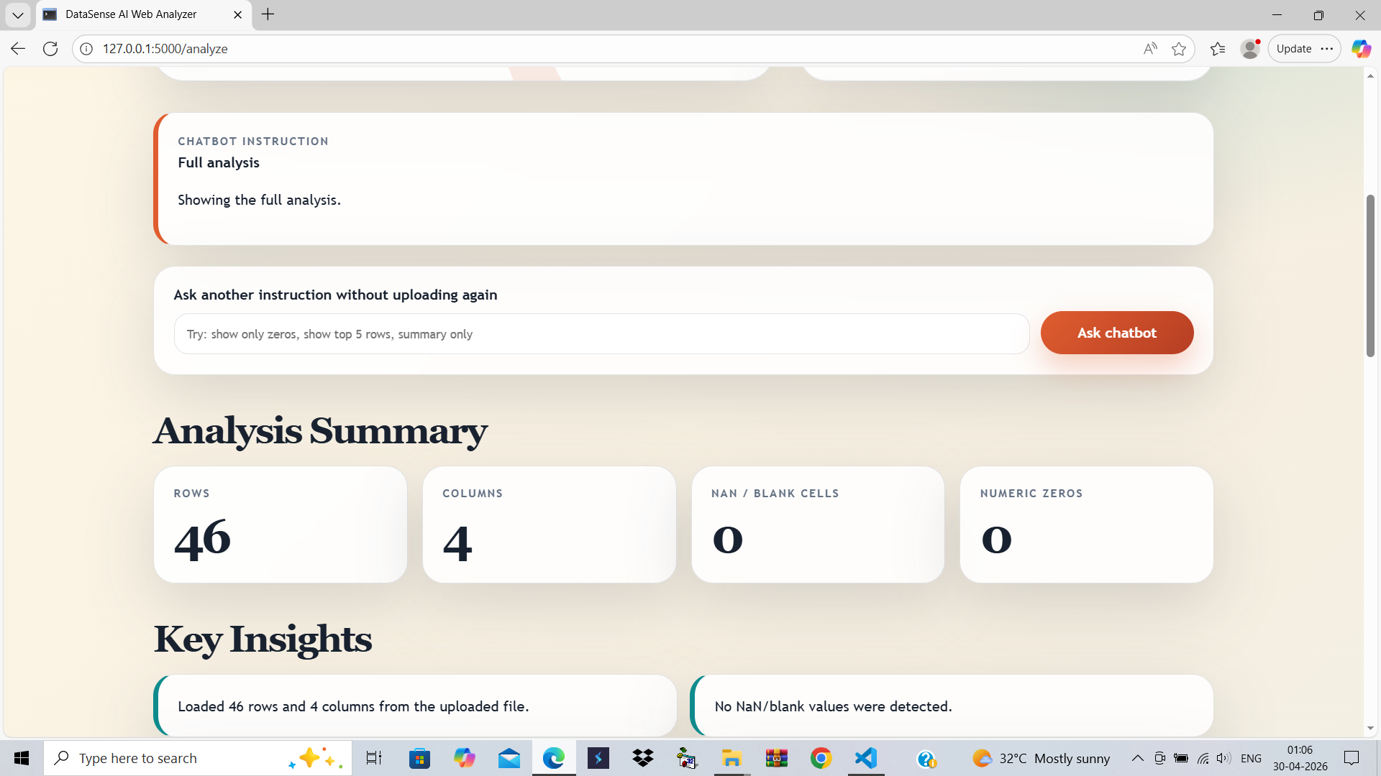
: Over View Pages :
This Photo by Unknown Author is licensed under CC BY-SA-NC

Slide 11
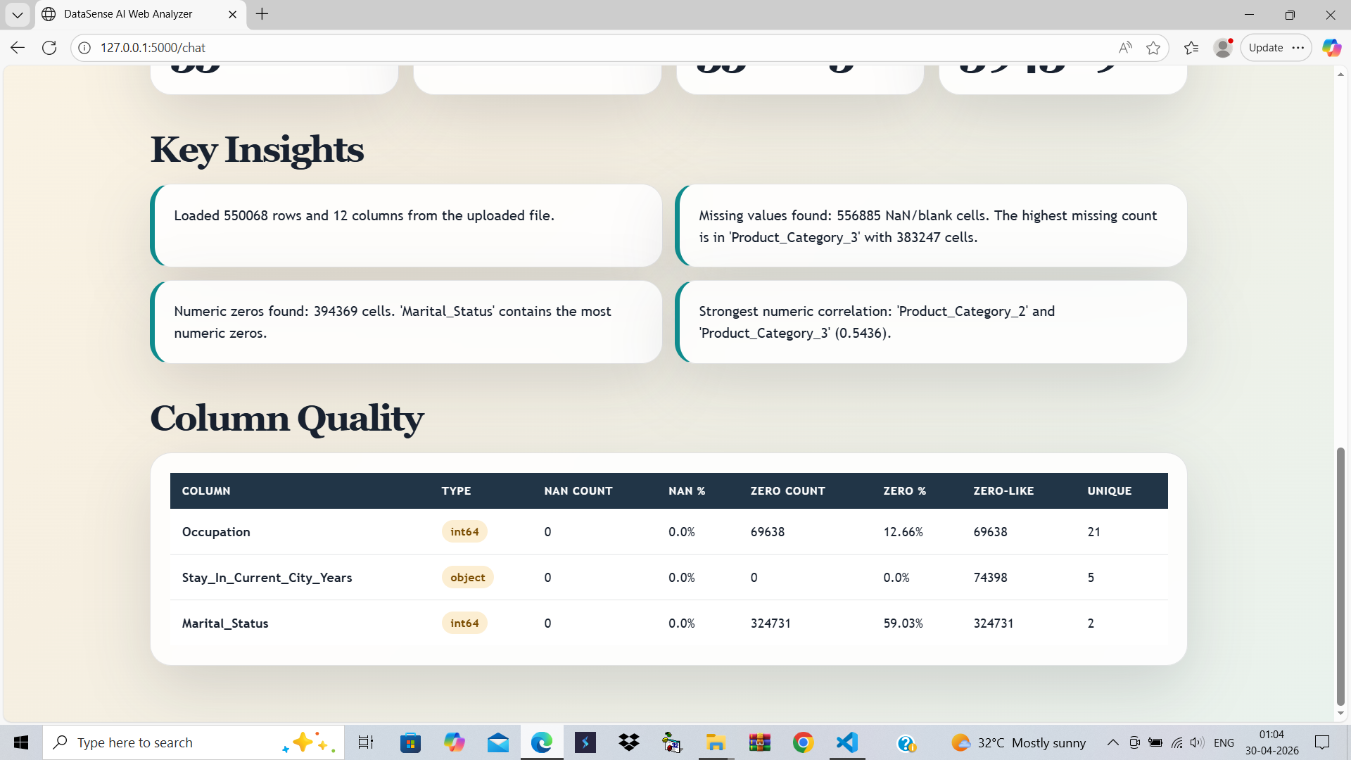
: Analysis Page :
This Photo by Unknown Author is licensed under CC BY-SA-NC

Slide 12
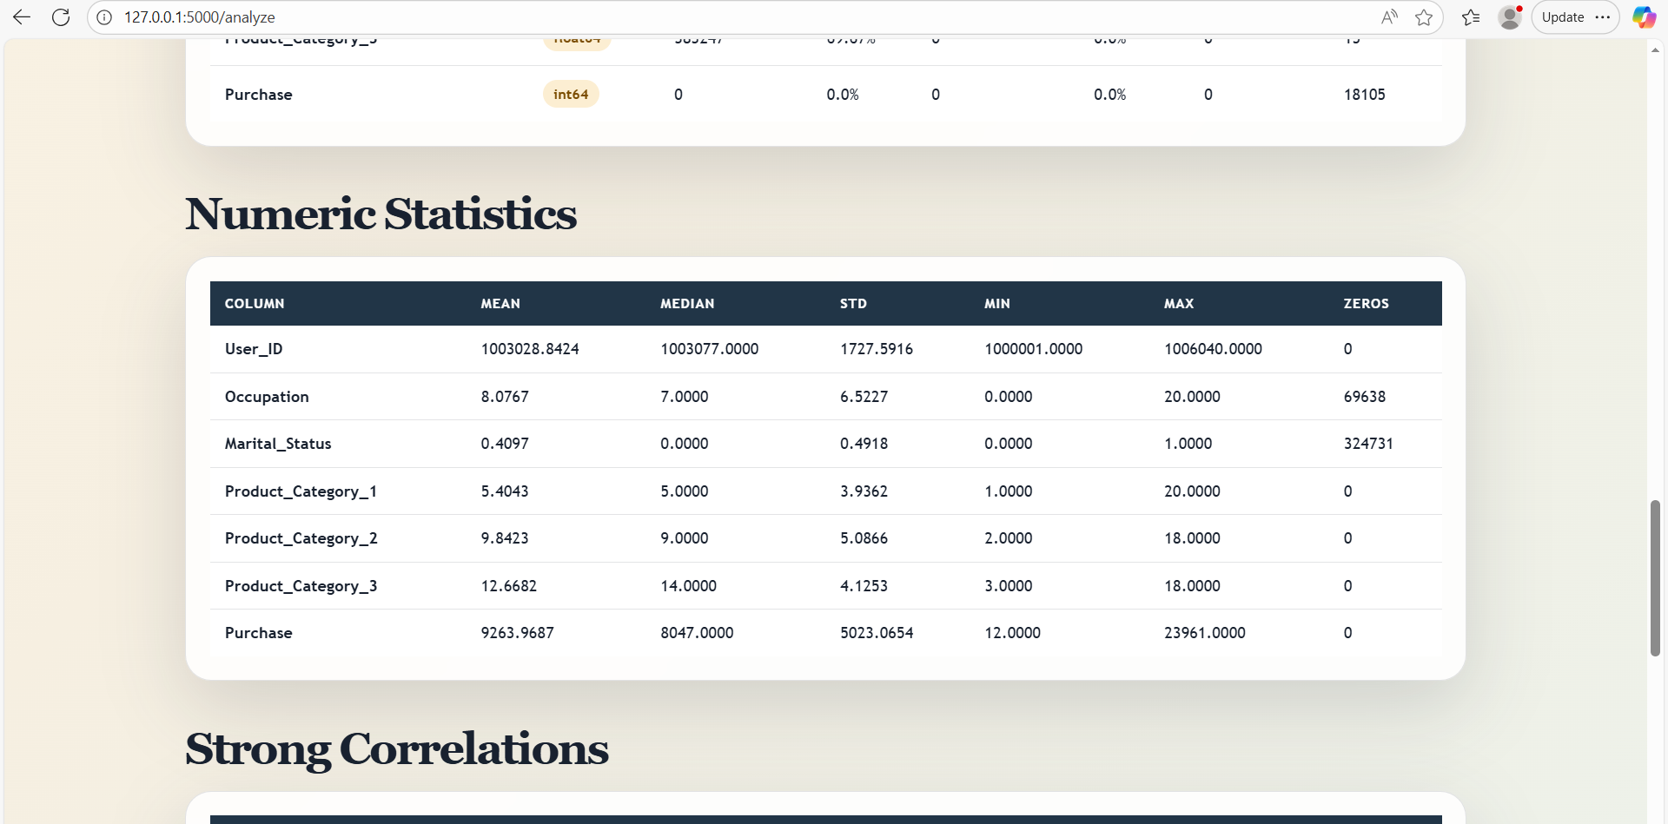
: After Analysis :
This Photo by Unknown Author is licensed under CC BY-SA-NC

Slide 13
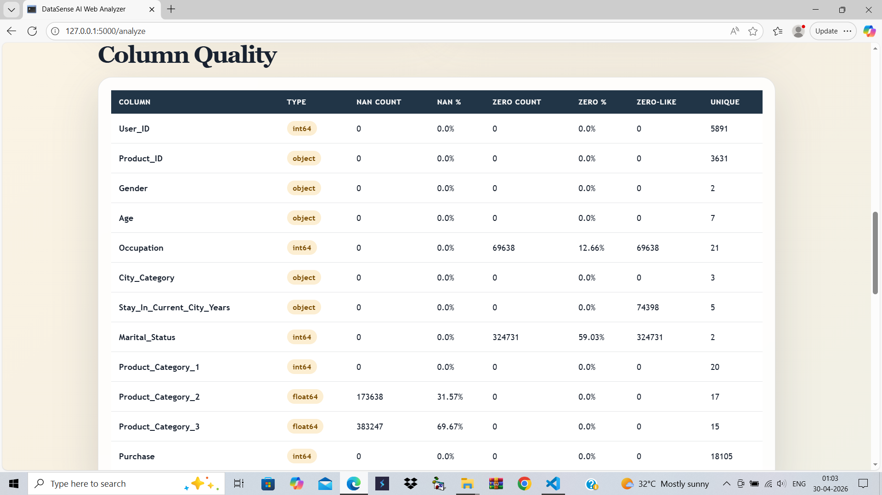
:Data Valuation:
This Photo by Unknown Author is licensed under CC BY-SA-NC

Slide 14
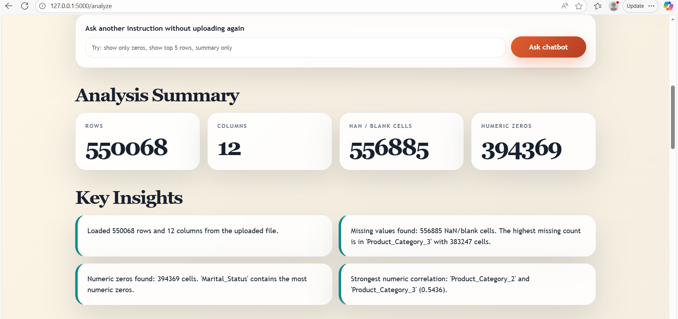
:Data Valuation:
This is the chatbot where we can ask every query related the csv file or the excel file. (eg. Rows , show 5 first rows, min, max, medium etc)
This Photo by Unknown Author is licensed under CC BY-SA-NC

Slide 15
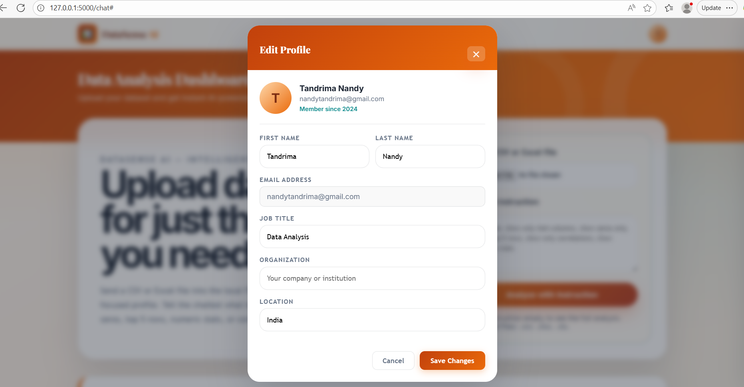
: Profile Edit :
This Photo by Unknown Author is licensed under CC BY-SA-NC

Slide 16
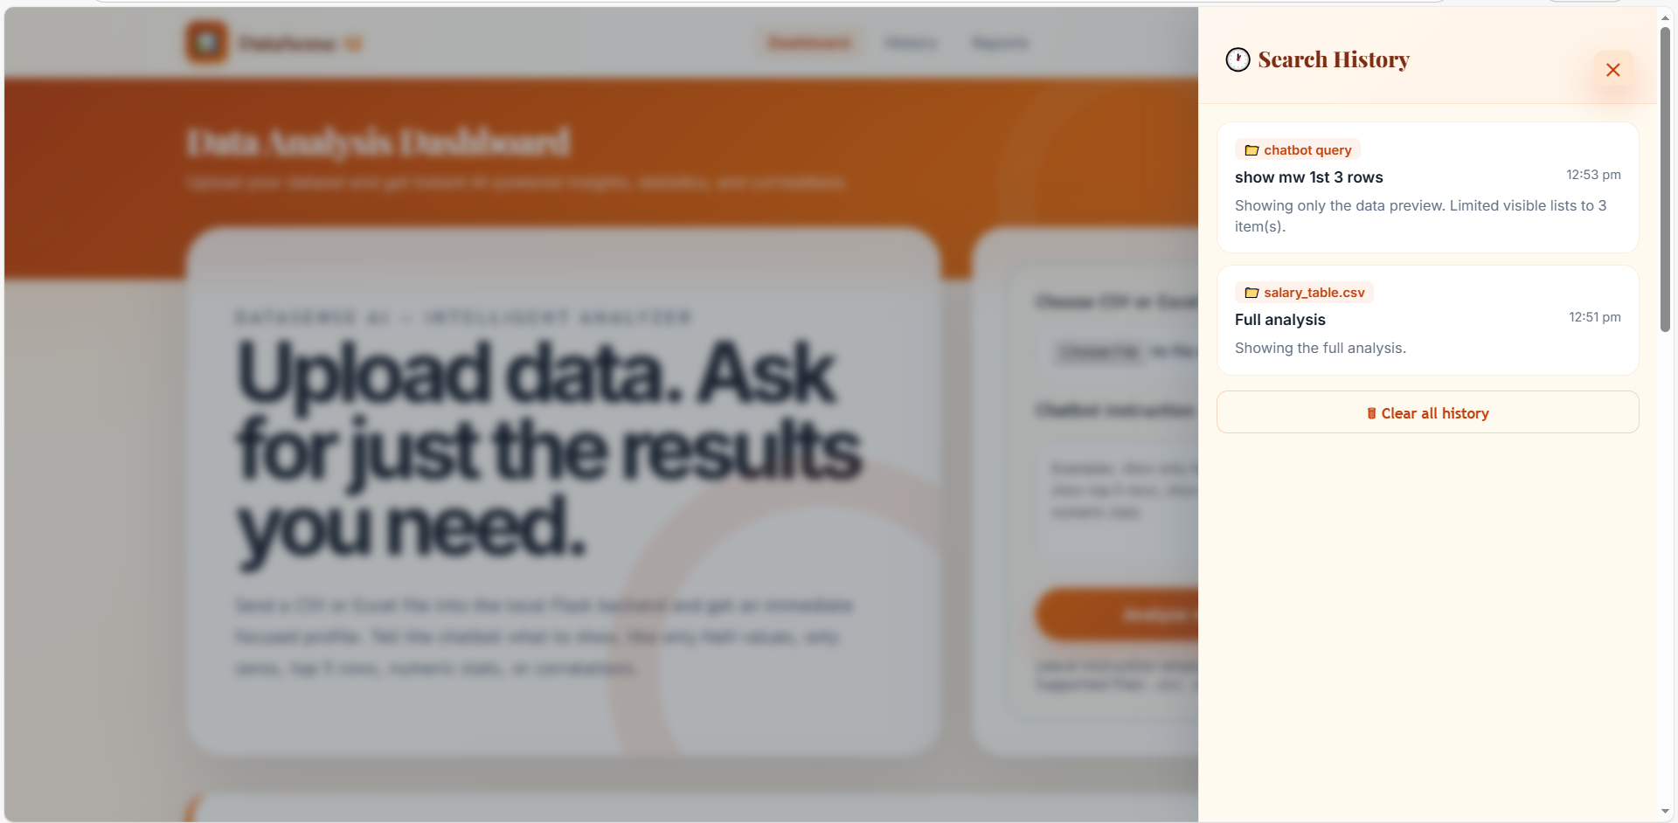
: History Check :
This Photo by Unknown Author is licensed under CC BY-SA-NC

Slide 17
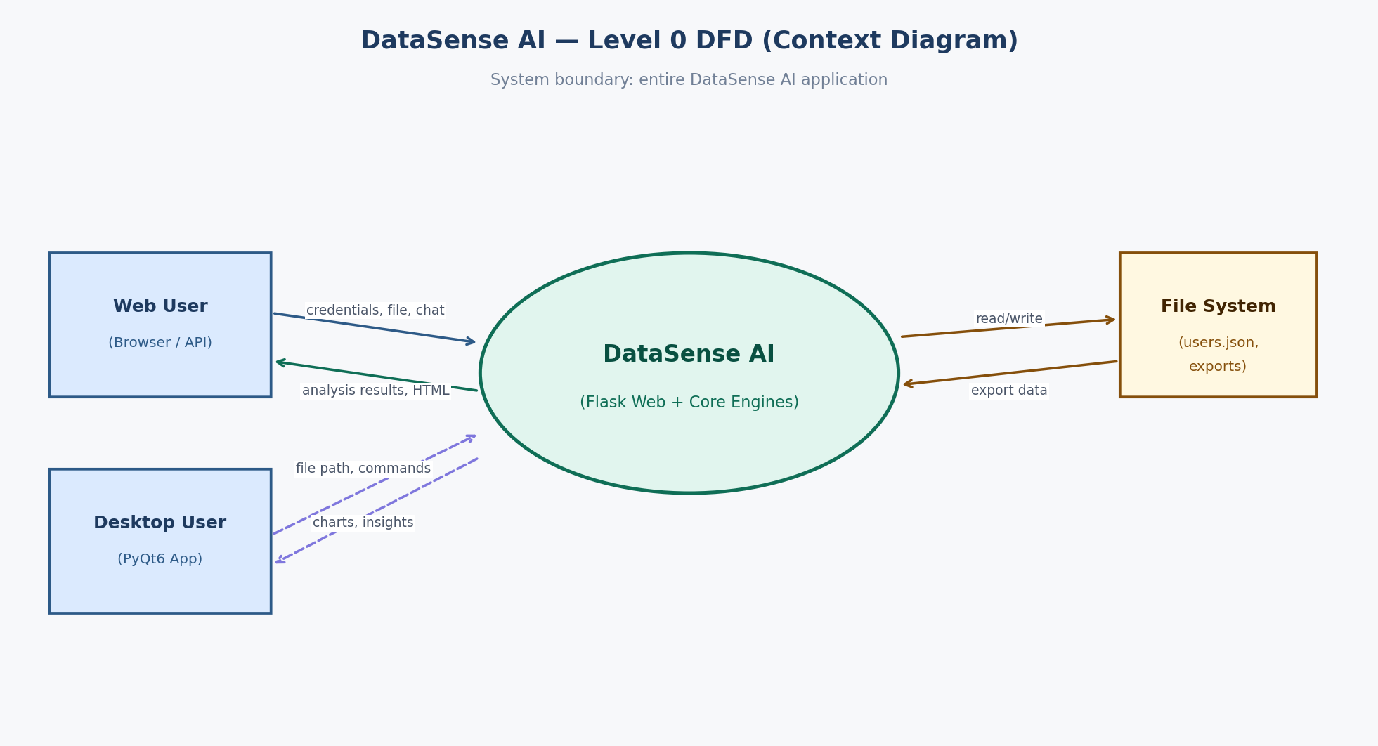
DFD DIAGRAM :
The proposed system, DataSense AI, is designed to provide an intelligent, automated, and user-friendly platform for data analysis. The solution integrates artificial intelligence techniques with modern data processing tools to transform raw datasets into meaningful insights. The system follows a modular architecture where each component is responsible for a specific task such as data input, preprocessing, analysis, visualization, and result presentation. This approach ensures scalability, maintainability, and efficient performance
This Photo by Unknown Author is licensed under CC BY-SA-NC

Slide 18
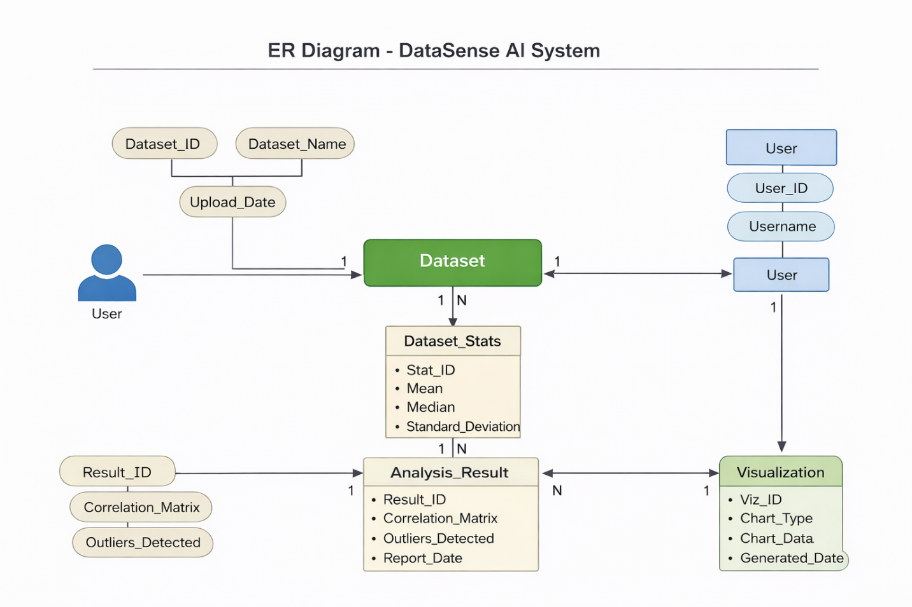
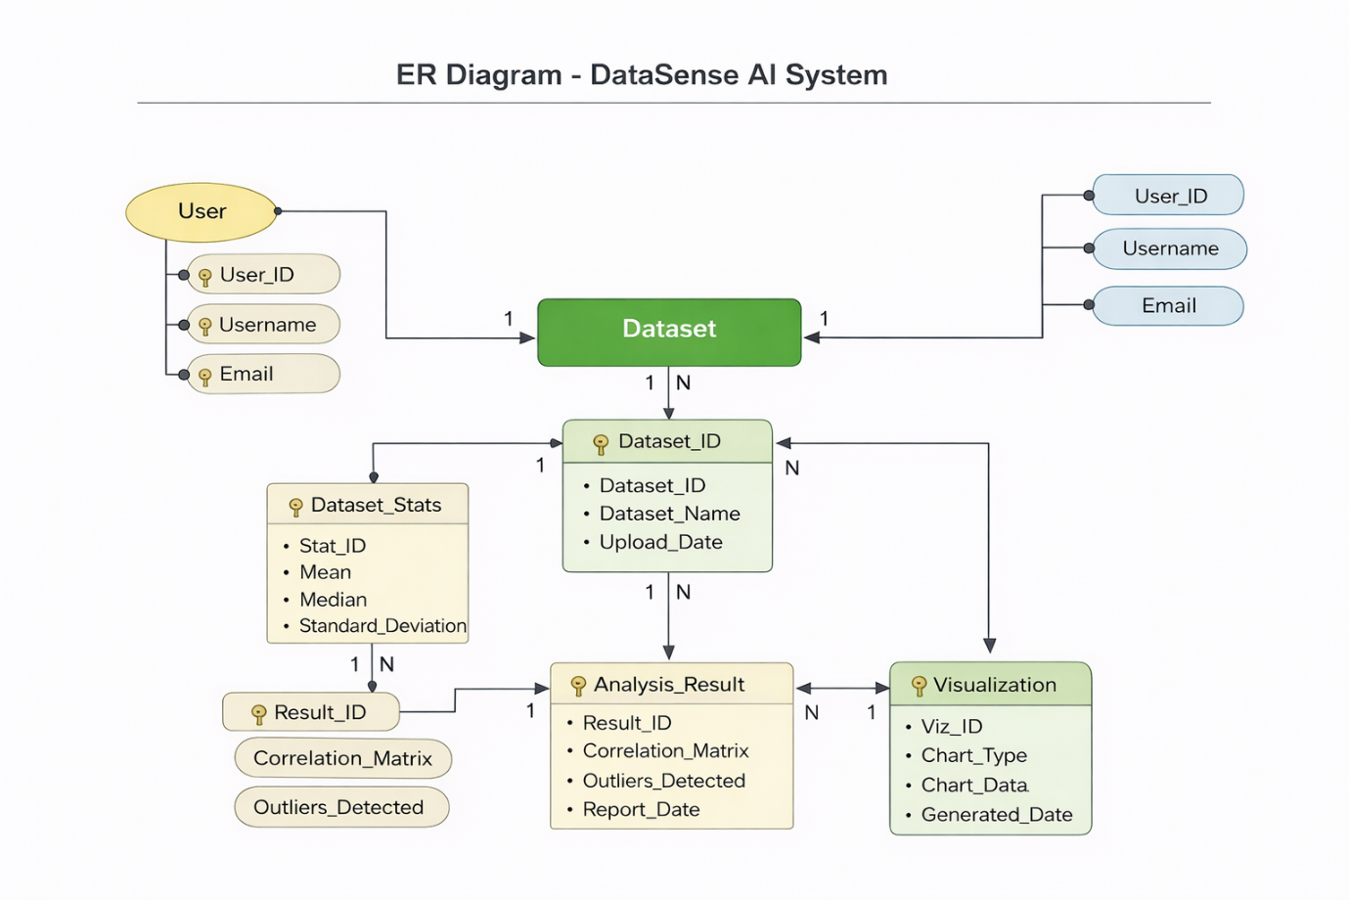
1st ER DIAGRAM
2nd ER DIAGRAM
This Photo by Unknown Author is licensed under CC BY-SA-NC

Slide 19
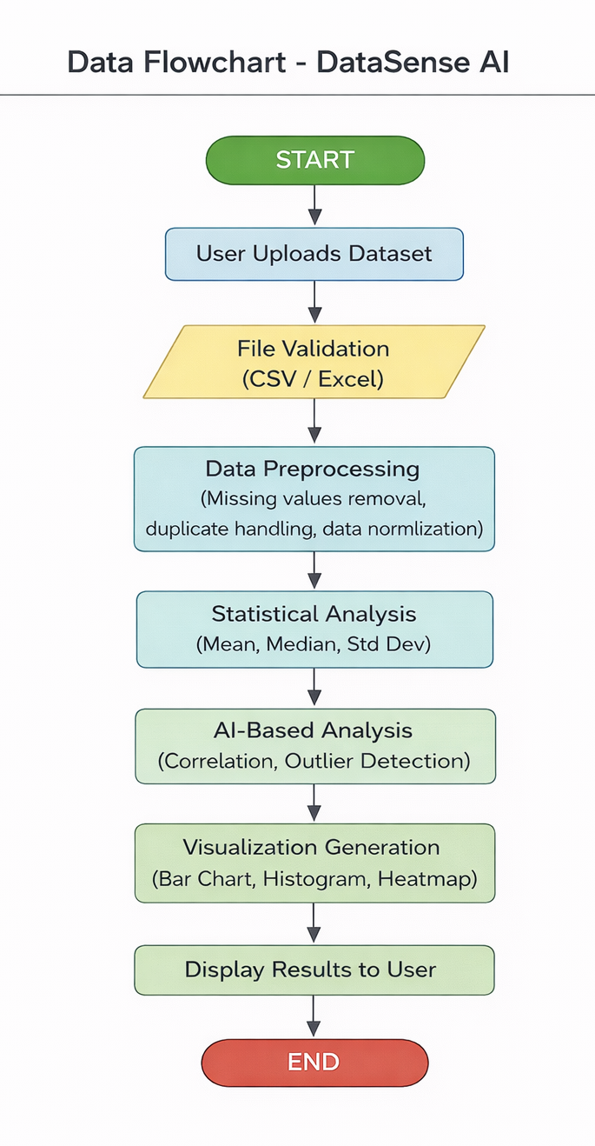
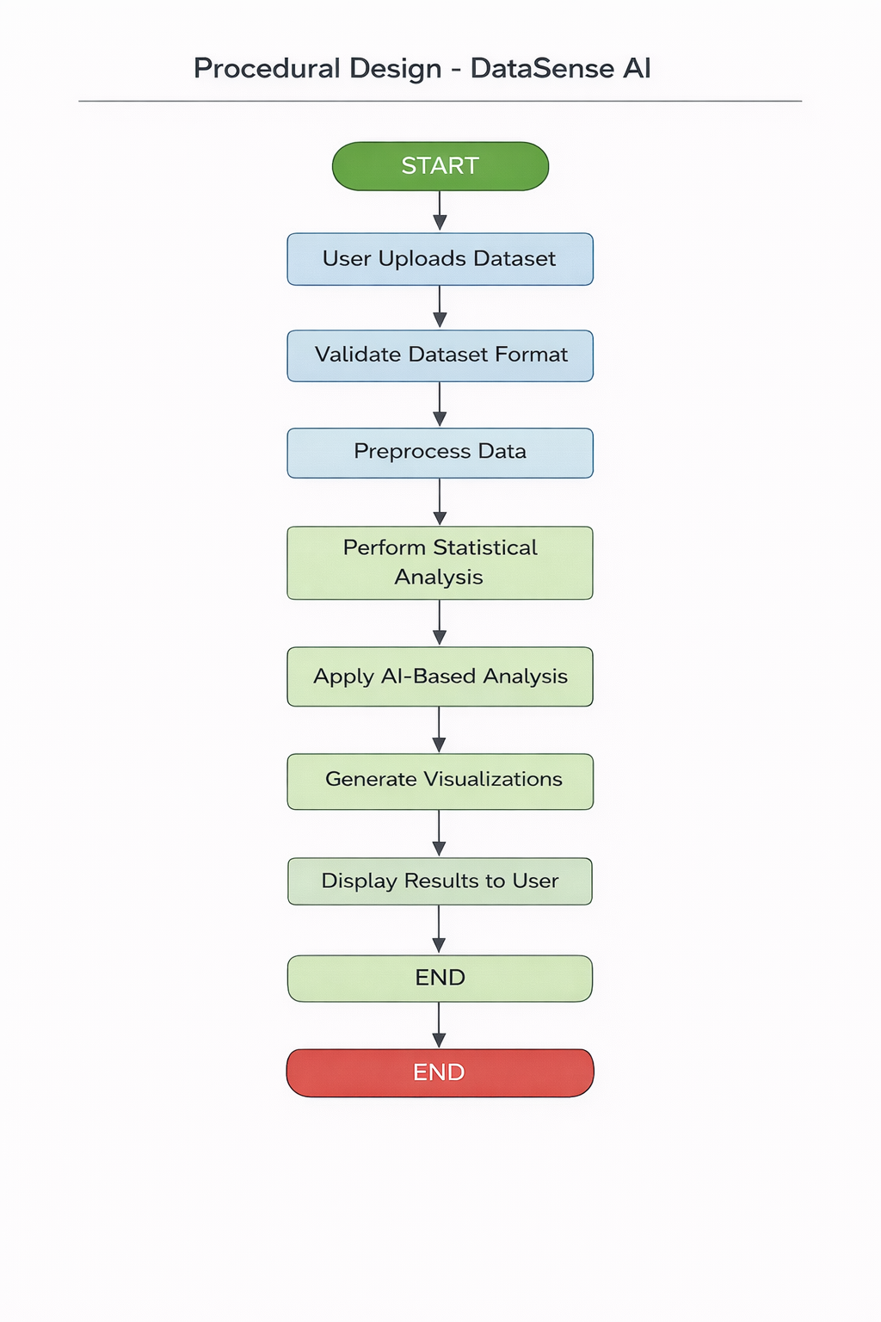
The data flow begins when the user uploads a dataset through the system interface. The system first validates the file format to ensure compatibility. Once validated, preprocessing operations are applied to improve data quality. The cleaned dataset is then passed through statistical and AI-based analysis modules. Finally, the system generates visual outputs and analytical insights, which are displayed on the dashboard for user interpretation.
This Photo by Unknown Author is licensed under CC BY-SA-NC

Slide 20
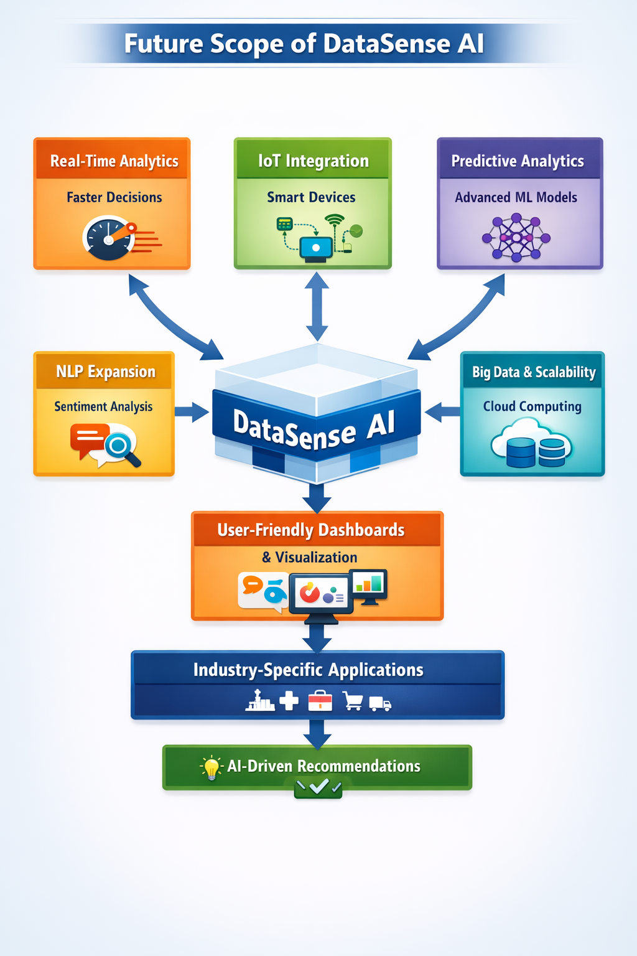
Future Goals (Market needs based) :
Real-Time Decision Support: Develop the system to process live data streams and provide immediate insights for faster and more accurate decision-making.
Advanced AI Integration: Implement deep learning and reinforcement learning models to enhance predictive capabilities and handle more complex datasets.
Scalable Architecture: Expand the platform using cloud computing and big data frameworks to manage enterprise-level data efficiently.
Cross-Industry Applications: Customize DataSense AI for various industries like healthcare, finance, logistics, and retail, enabling domain-specific insights.
Enhanced User Experience: Build interactive dashboards and visualization tools to make insights easily accessible for non-technical users.
Automated Recommendations: Incorporate AI algorithms to provide actionable suggestions, helping organizations make smarter, data-driven decisions.
This Photo by Unknown Author is licensed under CC BY-SA-NC

Slide 21
Conclusion :
The DataSense AI project demonstrates the significant potential of artificial intelligence in transforming raw and unstructured data into meaningful insights. By leveraging AI algorithms, the system efficiently analyzes large datasets, identifies patterns, and provides predictive and actionable intelligence, which is invaluable for informed decision-making. This project highlights the advantages of automation in data processing, reducing human effort, minimizing errors, and accelerating analysis.
The implementation of DataSense AI proves that combining machine learning techniques with advanced data analytics can lead to smarter, faster, and more accurate interpretations of data. Overall, this project not only showcases technical proficiency in AI and data handling but also underlines the practical applicability of AI-driven analytics across industries. The results obtained validate the system’s effectiveness and pave the way for future enhancements, including integration with real-time data streams and expansion to broader datasets.
This Photo by Unknown Author is licensed under CC BY-SA-NC

Slide 22
THANK YOU
This Photo by Unknown Author is licensed under CC BY-SA-NC

